Slide 1
Science, Religion and Philosophy
Man’s search for the Truth
September 2018
Gokulmuthu Narayanaswamy

Slide 2
Introduction
Name
Education
Profession (if not student)
Belief
Passion or Purpose

Slide 3
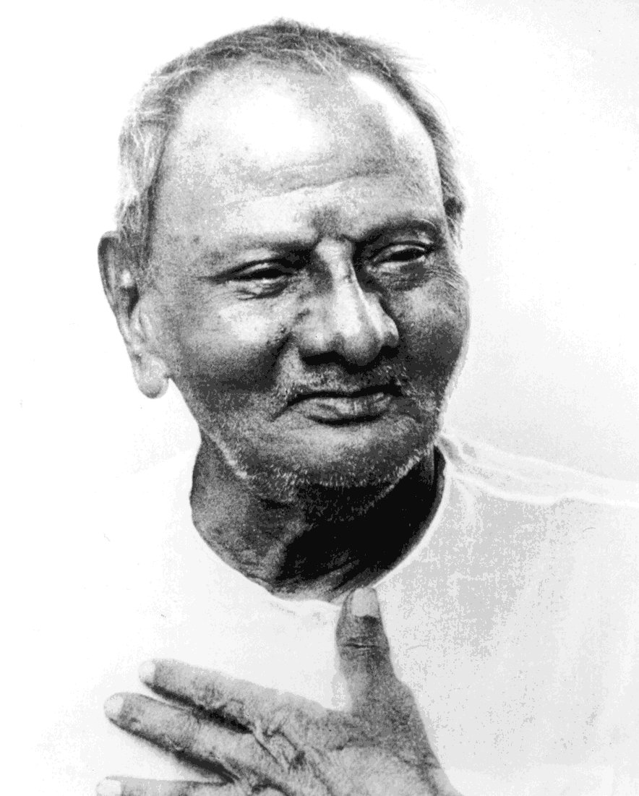
Search of Truth
If you expect any benefits from your search, material, mental or spiritual, you have missed the point. Truth gives no advantage. It gives you no higher status, no power over others; all you get is truth and the freedom from the false.
Sri Nisargadatta Maharaj

Slide 4
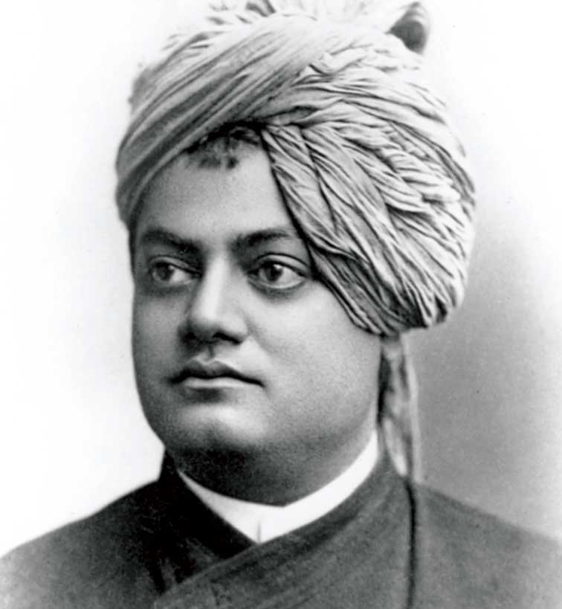
Search of Truth
Follow truth wherever it may lead you; carry ideas to their utmost logical conclusions. Do not be cowardly and hypocritical. … "Comfort" is no test of truth; on the contrary, truth is often far from being "comfortable." … Everything can be sacrificed for truth, but truth cannot be sacrificed for anything.
- Swami Vivekananda

Slide 5
Six Questions - Exercise
What is the nature of the individual (me)?
What is the nature of God?
What is the nature of the world?
Why is there human suffering?
What is the state beyond suffering?
What is the means to that state?

Slide 6
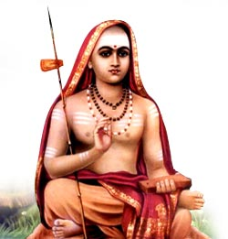
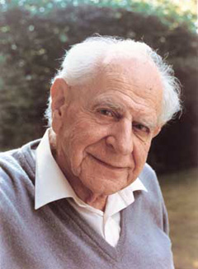
Domain of Science
Sankara (788-820)
indriya vishaya – Accessible to senses and extensions
ati indriya vishaya – Not accessible to senses
Karl Popper (1902-94)
Verifiable (Falsifiable)
Non-verifiable (Non-falsifiable)

Slide 7
Beyond Science
Non-verifiable
Is there free-will?
“If you do good, you will get good.”
Is there anything other than matter?
Unexplainable
How did Srinivasa Ramanujam get his formulae?
Why is the universe not homogeneous and isotropic?
Why should a person not commit suicide?
Why should a person be honest or compassionate?

Slide 8
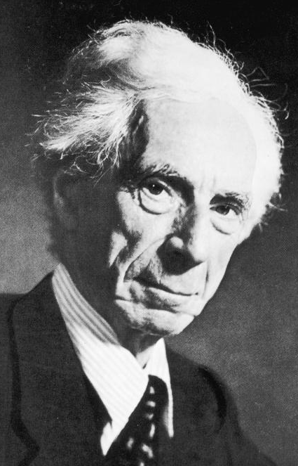
Why Study Philosophy?
Philosophy is to be studied, not for the sake of any definite answers to its questions since no definite answers can, as a rule, be known to be true, but rather for the sake of the questions themselves; because these questions enlarge our conception of what is possible, enrich our intellectual imagination and diminish the dogmatic assurance which closes the mind against speculation; but above all because, through the greatness of the universe which philosophy contemplates, the mind also is rendered great, and becomes capable of that union with the universe which constitutes its highest good.
- Bertrand Russell

Slide 9
Domain of Philosophy
Philosophy
Epistemology
Axiology
Metaphysics
Ethics
Aesthetics
Satyam
Shivam
Sundaram

Slide 10
Epistemology
Immediate
Laukika
Mediate
(mati) Anumaana
(sutra) Sabda
Alaukika
(kevala jnana) [yogaja]
Anumaana, Upamaana, Arthaapatti, Anupalabdhi
Laukika
Alaukika
Drsya
Drk
Knowledge
5 indriya
[manasa]
[saamaanya lakshana]
[jnaana lakshana]
(avaadi) Pratyaksha
(manapraagya)

Slide 11
Ontology / Metaphysics
Fundamental Entity
Dualism
Monism
Matter
Science, Vaibhaasika Buddhism
Advaita
Sunya
Maadhyamika Buddhism
Matter, Mind
Matter, Mind, God
Sautraantika Buddhism
Dvaita
Mind
Visista advaita
Nirguna Brahman
Yogaacaara Buddhism
God

Slide 12
Some Creation Theories
asat kaarya vaada
Caaruvaaka, Vaibhaasika, Sautraantika, Nyaaya, Vaiseshika
sat kaarya vaada
parinaama vaada
vivarta vaada
sat asat kaaraya vaada
Jainism, Purva mimaamsa
Prakriti
Sankhya, Yoga
Saguna Brahma
Visista advaita
Sunyata
Maadhyamika (Sunya vaada)
Vijnaana
Yogaachara (Vijnaana vaada)
Nirguna Brahma
Advaita

Slide 13
Philosophy vs Religion
Philosophy
No assumption or conclusion
Work on all the possibilities
Intellectual exercise
Religion
Make an assumption to believe
Build a self-consistent logical system
Build a culture and stories illustrating it
Build rituals and practices to work with it
Head
Heart
Hand

Slide 14
Materialism (Science)
All that exists is material only.
All thoughts are the effect of chemical and electrical activity in the brain.
“Self” is an illusion.
Free-will is an illusion.
There is no real right or wrong, because there is no real agent making the decision.
Individual accountability is without any basis.
There is no purpose or meaning to life.

Slide 15
Six Questions - Materialism
What is the nature of the individual (me)?
What is the nature of God?
What is the nature of the world?
Why is there human suffering?
What is the state beyond suffering?
What is the means to that state?

Slide 16
Exercise
If you are given Rs.1,00,000 to spend on anything, what will you spend on?

Slide 17
What does man want?
Four pursuits of man (purushaartha)
Artha – Security, wealth
Kaama – Comfort, entertainment
Dharma – Morality, philanthopy
Moksha – Resilience, detachment
Popular prayer
saha nau avatu, saha nau bhunaktu
saha viryam karavaavahai, tejasvinah avaditamastu
Indian flag

Slide 18
Purpose of Religion
Dharma – Morality
Inspired by what, will a person be truthful, non-violent and self-controlled, even to death?
Moksha – Resilience
Inspired by what, will a person be cheerful and active inspite of the ups and downs in life?

Slide 19
Expectation from Religion
Two types of people:
Immature – Selfish – What is in it for me?
Mature – Altruistic – Sees himself in other’s place.
Religion should inspire both these types of people to be moral and resilient.

Slide 20
Principles of Vedaanta
Assumption 1: Freewill and Moral causality
Individual (Jiva) is the holder of freewill.
Strict moral causality (Law of Karma).
Fairness and justice in the whole system.
Nothing is lost, even by death.
Assumption 2: Conscious Totality (Isvara)
abhinna upaadaana nimitta prayojana kaarana
Transcendent and immanent
Context sensitive interface
Sustenence by being Conscious

Slide 21
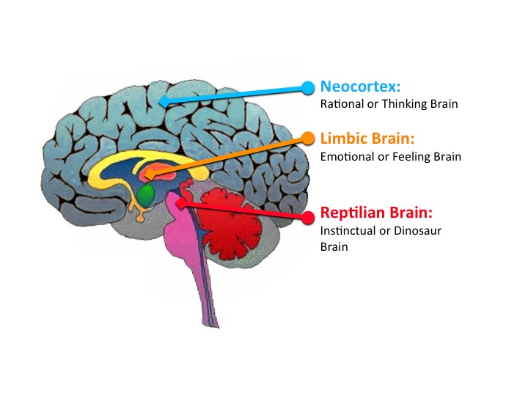
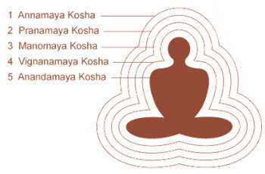
The Individual (Jiva)
Gross body
Subtle body
{
4
3
2
Causal body
Freewill, Tendencies, Karma

Slide 22
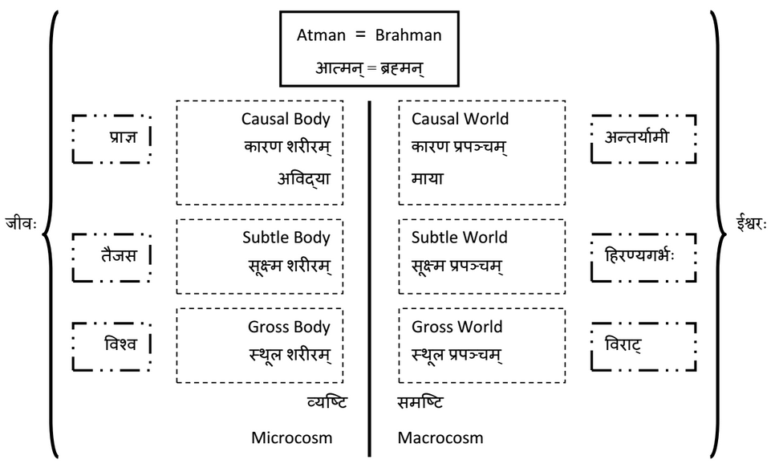
Jiva and Isvara

Slide 23
Principles of Vedaanta
Jiva uses body, mind and intellect to make decisions and do action. Is responsible for action.
Isvara is omniscient, omnipotent and compassionate.
Prayer and austerities are also actions.
Karma is reflective. Wishing harm will bring harm.
Worldly desires keep the cycle going.
Complete freedom from worldly desires will lead to freedom from the cycle.

Slide 24
Evolution
Matter vs Life
Biological evolution
Eat, sleep, self-protection, procreation
Technological, Cultural, Moral evolution
Multiply consumption: tools, medicine, agriculture, gadgets
Refine consumption: art, family, society, education
Resist biological instincts: collaboration, affirmative action, fasting, continence, compassion, equanimity
Spiritual evolution
Pinnacle of evolution and freedom
Giveup individuality: dispassion, sacrifice, freedom from ego

Slide 25
Morality
Is there a universal standard for morality?
Whatever you do, will come back to you.
Whatever you do, you actually are doing to your own higher self.
Golden Rule (Gita 6.32)
Do unto others what you would like others to do to you.
Farsight Rule (Gita 18.36-39)
Seek greater gain in the long term at the cost of some loss in the short term.
Selfish vs Selfless (Gita 18.23-25)
“To be selfish is immoral; to be unselfish is moral.” Swami Vivekananda

Slide 26
Morality
Identity Rule (Gita 18.20-22)
Whatever is done by identifying yourself and others as mind, and not body is good.
Ideal Person Rule (Gita 3.21,25,26)
What would Rama/Buddha/Vivekananda/… do?
Self Declaration Rule (Gita 11.36)
Can you proudly tell what you did to your mother?
Buddha’s Rule
bahu jana sukhaaya bahu jana hitaaya
Greatest good for the greatest number of people for greatest length of time.

Slide 27
Six Questions - Vedaanta
What is the nature of the individual (me)?
What is the nature of God?
What is the nature of the world?
Why is there human suffering?
What is the state beyond suffering?
What is the means to that state?

Slide 28
Einstein talks Vedaanta!
A human being is part of the whole called by us universe, a part limited in time and space. We experience ourselves, our thoughts and feelings as something separate from the rest. A kind of optical delusion of consciousness. This delusion is a kind of prison for us, restricting us to our personal desires and to affection for a few persons nearest to us. Our task must be to free ourselves from the prison by widening our circle of compassion to embrace all living creatures and the whole of nature in its beauty. The true value of a human being is determined primarily by the measure and the sense in which they have obtained liberation from the self.
- Albert Einstein

Slide 29
Time for a break !!!
http://www.practicalphilosophy.in

Slide 30
Six Questions - Exercise
What is the nature of the individual (me)?
What is the nature of God?
What is the nature of the world?
Why is there human suffering?
What is the state beyond suffering?
What is the means to that state?

Slide 31
Principles of Vedaanta
Assumption 1: Freewill and Moral causality
Individual (Jiva) is the holder of freewill.
Strict moral causality (Law of Karma).
Fairness and justice in the whole system.
Nothing is lost, even by death.
Assumption 2: Conscious Totality (Isvara)
Transcendent and immanent
abhinna nimitta upaadaana prayojana kaarana
Context sensitive interface
Sustenence by being Conscious

Slide 32
Problems (Sample)
Where did the cause and effect cycle (karma and janma cycle) start?
None of them can be the beginning.
If it is without beginning, how can it end?
If end of the cycle is freedom, freedom will be limited.
Can Isvara be the cause of the world?
Being cause => subject to change. Change => intention. Intention => desire. Desire => dissatisfaction.
Also change implies subject to time and space.

Slide 33
Advaita Vedaanta
Brahmavid aapnoti param
Satyam Jnaanam Anantam Brahma
Yo veda nihitam guhaayaam parame vyoman
So ashnute sarvaan kaamaan saha
Brahmanaa vipascita

Slide 34
Satyam
Satyam - Existence
Limitations of perception
All properties are emergent
What is the nature of the fundamental substance?
Nirguna – free from properties
Nirvikaara – free from change
Nitya and sarvagata – eternal and omnipresent
Ekam - single

Slide 35
Jnaanam
Jnaanam - Conciousness
Subject – object relationship
I am the Ultimate Subject, which can never be an object
Properties belong to objects only
What is the nature of I, the Ultimate Subject?
Nirguna – free from properties
Nirvikaara – free from change
Nitya and sarvagata – eternal and omnipresent
Ekam - single

Slide 36
Advaitam
Jnaanam = Satyam
I, the Consciousness am the fundamental substance of the entire Universe.
Space in the hall Vs. Space outside the hall
Space is not in the hall. Hall is in space.
Universe exists in Me !!!

Slide 37
Maaya
What is the nature of the Universe?
Analysis of Finite Vs. Infinite
Number line as example
Inference:
Infinite exists from the point of view of finite
Finite does not exist from point of view of Infinite
This is called Maaya
Universe exists only from point of view of finite. It has a relative, dependent existence.

Slide 38
Advaita Summary
Summary:
Brahma satyam
Jagat mityaa
Jivah Brahma eva na aparah
Jiva-jagat-isvara model is not negated. It is valid in the relative realm.
Individuality is an illusion.
Giving up the reality attributed to the concept of individuality is Moksha.

Slide 39
Advaita Vedaanta
Brahmavid aapnoti param
Satyam Jnaanam Anantam Brahma
Yo veda nihitam guhaayaam parame vyoman
So ashnute sarvaan kaamaan saha
Brahmanaa vipascita

Slide 40
Six Questions - Advaita
What is the nature of the individual (me)?
What is the nature of God?
What is the nature of the world?
Why is there human suffering?
What is the state beyond suffering?
What is the means to that state?

Slide 41
Bhagavad Gita
The goal of the Bhagavad Gita is to enable a person to live as a good human being and to face all situations in life with poise outside and peace inside.
This is done by a unique method of combining self-control, forbearance, kindness and knowledge, with a good dose of devotion to God (Ishvara).

Slide 42
Four Core Teachings (12.3-4)
सन्नियम्येन्द्रियग्रामं – Keep the senses and mind under control
सर्वत्र समबुद्धयः – Maintain equanimity in all situations
सर्वभूतहिते रताः – Engage in the welfare of all living beings
अव्यक्तं पर्युपासते – Understand God to be the Pure Consciousness behind the Universe and the living beings
You try your best for the first three. God will take care of the last one. (10.10-11, 12.6-7)

Slide 43
सन्नियम्य इन्द्रिय ग्रामं
Keep the senses and mind under control
The quality of your life depends on the quality of your mind. A mind under your control is like a friend. A mind not under your control is like an enemy. (6.5-6)
You cannot directly control the random thoughts in the mind. But you can decide whether to pursue the thoughts or not. (2.62)
Practice moderation in food, rest, work, etc. (6.16)
Psychological dependency on people, objects and situations comes by repeatedly thinking about them. Such attachment will lead to psychological problems like lust, greed, anger, arrogance, jealousy and delusion. Avoid these binding thoughts. (2.62-63)
How? Fill the mind with positive thoughts, stories in the life of saints and devotees, glories of God, name of God, etc.

Slide 44
सर्वत्र सम बुद्धयः
Maintain equanimity in all situations
Life will have ups and downs. There will be pleasure, pain, gain, loss, success, failure, fame, infamy, etc. (2.14, 2.38)
What you face now is the result of some of your current effort and some of your past actions. What you will face in future will be influenced by your current actions. You are the maker of your destiny. You get exactly what you deserve. Accept adverse life situations without complaining and do things differently next time. (2.47-48)
Do your duty and be ready for any situation. (6.1)
Accept success with humility and failure with dignity.
How? Do all actions as offerings to God and accept all results as gifts from God.

Slide 45
सर्व भूत हिते रताः
Engage in the welfare of all living beings
Do not intend harm to any living being. Avoid harm as much as possible. (17.14)
Help other human and living beings as much as possible.
Serve the underprivileged people, without expecting anything in return, to get basic necessities like food, shelter, clothes, education, health care, emotional support and dignified livelihood. (17.20)
Treat people and animals with kindness.
Take special care of children, aged and disabled people.
How? See God as the ultimate inner recipient of the service done to every living being. (5.29)

Slide 46
अव्यक्तं पर्युपासते
Understand God to be the Pure Consciousness behind the Universe and the living beings
It is God alone who appears as this Universe and all the living beings. (13.13-15)
God is the material out of which the whole Universe is made of. (7.4)
Everything has come from God, exists in God and will merge back into God. (10.20)
God is the Pure Consciousness behind the Universe and the living beings. (13.3)
There is no real individuality. (18.20-21)
How? God can be seen as the whole Universe outside (including the body and mind) and as the Pure Consciousness within oneself.

Slide 47
Thank you !!!
http://www.practicalphilosophy.in

