Slide 1
Science, Religion and Philosophy
Man’s search for the Truth
Gokulmuthu Narayanaswamy

Slide 2
Search of Truth
If you expect any benefits from your search, material, mental or spiritual, you have missed the point. Truth gives no advantage. It gives you no higher status, no power over others; all you get is truth and the freedom from the false.
Sri Nisargadatta Maharaj

Slide 3
Vedanta …
The true Vedantic spirit does not start out with a system of preconceived ideas…. each man has been entirely free to search wherever he pleased for the spiritual explanation of the spectacle of the universe.
– Romain Rolland (French Nobel Laureate)

Slide 4
Six Questions
What is the nature of the sentient individual (me)?
What is the nature of the universal?
What is the nature of the insentient world?
Why is there human suffering?
What is the state beyond suffering?
What is the means to the state beyond suffering?

Slide 5
Success of Science
Based on strict cause and effect
Rigorous process
Credible system of peer review of research
Universal across cultures
Mathematics to check human errors and personal biases
Resulted in useful technology

Slide 6
Science in Search of Truth
Reductionism and emergence
Vague at higher levels
Objective reality
Perception coloured by other factors
Verifiable concepts
Non-verifiables – freewill, materialism
Occam’s razor
Srinivasa Ramanujam

Slide 7
Six Questions
What is the nature of the sentient individual (me)?
What is the nature of the universal?
What is the nature of the insentient world?
Why is there human suffering?
What is the state beyond suffering?
What is the means to the state beyond suffering?

Slide 8
Why Religion?
Four pursuits of man
Artha – Security
Kama - Comfort
Dharma – Morality
Inspired by what, will a person be truthful, non-violent and self-controlled, even to death?
Moksha – Resilience
Inspired by what, will a person be cheerful and active inspite of the ups and downs in life?

Slide 9
Method of Religion
Two types of people:
Immature – Selfish – What is in it for me?
Mature – Altruistic – Sees himself in other’s place.
Religion should inspire both these types of people to be moral and resilient.

Slide 10
Principles of Vedanta
Assumption 1: Freewill and Moral causality
Individual (Jiva) is the holder of freewill.
Strict moral causality (Law of Karma).
Fairness and justice in the whole system.
Nothing is lost, even by death.
Assumption 2: Conscious Totality (Isvara)
Transcendent and immanent
abhinna nimitta upaadaana kaarana
Context sensitive interface
Sustainence by being Conscious

Slide 11
Principles of Vedanta
Isvara is omniscient and omnipotent.
Prayer and austerities are also actions.
Karma is reflective. Wishing harm will bring harm, etc.
Finite desires keep the cycle going.
Complete freedom from worldly desires will lead to freedom from the cycle.
Get out of the race !!!

Slide 12
Six Questions
What is the nature of the sentient individual (me)?
What is the nature of the universal?
What is the nature of the insentient world?
Why is there human suffering?
What is the state beyond suffering?
What is the means to the state beyond suffering?

Slide 13
Purpose
Dharma – Morality
Inspired by what, will a person be truthful, non-violent and self-controlled, even to death?
Moksha – Resilience
Inspired by what, will a person be cheerful and active inspite of the ups and downs in life?

Slide 14
Problems (Sample)
Where did the cause and effect cycle (karma and janma cycle) start?
None of them can be the beginning.
If it is without beginning, how can it end?
If end of the cycle is freedom, freedom will be limited.
Can Isvara be the cause of the world?
Being cause => subject to change. Change => intention. Intention => desire. Desire => dissatisfaction.
Also change implies subject to time and space.

Slide 15
Principles of Advaita Vedanta
Brahmavid aapnoti param
Satyam Jnaanam Anantam Brahma
Yo veda nihitam guhaayaam parame vyoman
So ashnute sarvaan kaamaan saha
Brahmanaa vipascita

Slide 16
Satyam
Satyam - Existence
Limitations of perception
All properties are emergent
What is the nature of the fundamental substance?
Nirguna – free from properties
Nirvikaara – free from change
Nitya and sarvagata – eternal and omnipresent
Ekam - single

Slide 17
Jnaanam
Jnaanam - Conciousness
Subject – object relationship
I am the Ultimate Subject, which can never be an object
Properties belong to objects only
What is the nature of I, the Ultimate Subject?
Nirguna – free from properties
Nirvikaara – free from change
Nitya and sarvagata – eternal and omnipresent
Ekam - single

Slide 18
Advaitam
Jnaanam = Satyam
I, the Consciousness am the fundamental substance of the entire Universe.
Space in the hall Vs. Space outside the hall
Space is not in the hall. Hall is in space.
Universe exists in Me !!!

Slide 19
Maaya
What is the nature of the Universe?
Analysis of Finite Vs. Infinite
Number line as example
Inference:
Infinite exists from the point of view of finite
Finite does not exist from point of view of Infinite
This is called Maaya
Universe exists only from point of view of finite. It has a relative, dependent existence.

Slide 20
Advaita Summary
Summary:
Brahma satyam
Jagat mityaa
Jivah Brahma eva na aparah
Jiva-jagat-isvara model is not negated. It is valid in the relative realm.
Individuality is an illusion.
Giving up the reality attributed to the concept of individuality is Moksha.

Slide 21
Principles of Advaita Vedanta
Brahmavid aapnoti param
Satyam Jnaanam Anantam Brahma
Yo veda nihitam guhaayaam parame vyoman
So ashnute sarvaan kaamaan saha
Brahmanaa vipascita

Slide 22
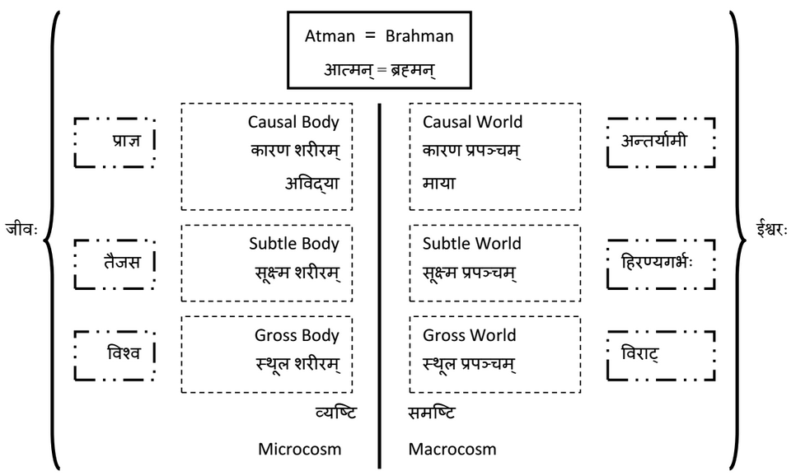
Jiva, Jagat and Isvara

Slide 23
Six Questions
What is the nature of the sentient individual (me)?
What is the nature of the universal?
What is the nature of the insentient world?
Why is there human suffering?
What is the state beyond suffering?
What is the means to the state beyond suffering?

Slide 24
Purpose
Dharma – Morality
Inspired by what, will a person be truthful, non-violent and self-controlled, even to death?
Moksha – Resilience
Inspired by what, will a person be cheerful and active inspite of the ups and downs in life?

Slide 25
Look who is talking Vedanta!
A human being is part of the whole called by us universe, a part
limited in time and space. We experience ourselves, our thoughts
and feelings as something separate from the rest. A kind of optical
delusion of consciousness. This delusion is a kind of prison for us,
restricting us to our personal desires and to affection for a few
persons nearest to us. Our task must be to free ourselves from the
prison by widening our circle of compassion to embrace all living
creatures and the whole of nature in its beauty. The true value of a
human being is determined primarily by the measure and the sense
in which they have obtained liberation from the self.
- Albert Einstein

Slide 26
Thank you !!!
Questions
http://www.practicalphilosophy.in

